Slide 1

The Bill of Rights
By: Jack Fitton and Elliot Figa

Slide 2


1st Amendment
Our definition:
The first amendment gave freedom of speech, freedom of religion, freedom of press, the right to assemble, and petition to the government.
The real definition:
Congress shall make no law respecting an establishment of the religion, or prohibiting the free exercise thereof; or abridging the freedom of speech, or of the press; or the right of the people peaceably to assemble, and to petition the government for a redress grievances.

Slide 3
1st Amendment
People are treated unfairly by their religion. Not only that, they also can’t say what they want to and can’t gather a group of people. That is when the first amendment came in and changed things to fair treatment.

Slide 4
2nd Amendment
Our definition:
The right to form a militia and the right to keep or bear arms.
The real definition:
A well regulated militia, being necessary to the security of a free state, the right of the people to keep and bear arms, shall not be infringed.

Slide 5
2nd Amendment
I know you shouldn’t carry around guns and try to harm people, but if you are just holding a gun not trying to harm anyone, you should be able to carry on with what your doing. That is why they made the 2nd amendment which let people carry guns around as long as they didn’t harm anyone.

Slide 6
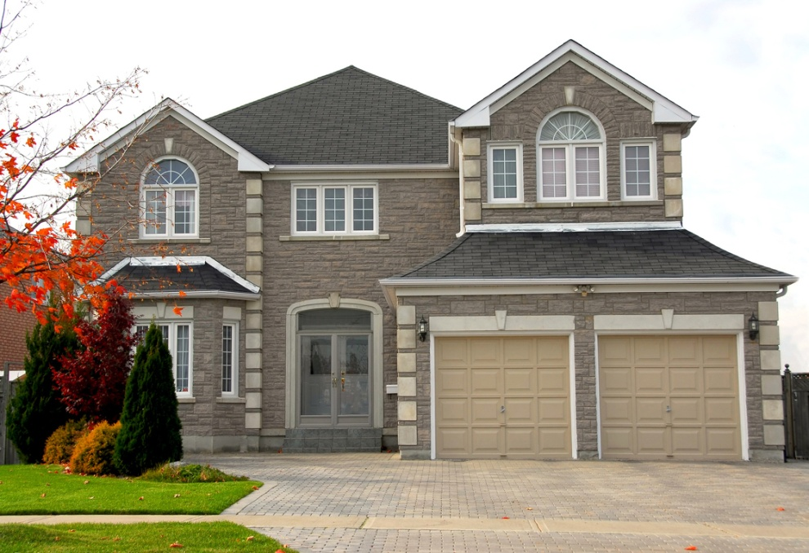
3rd Amendment
Our definition:
The right to not have soldiers stay in your home.
The real definition:
No Soldier shall, in time of peace be quartered in any house, without the consent of the Owner, nor in time of war, but in a manner to be prescribed by law.

Slide 7
3rd Amendment
How would you like it if a soldier just barged into your house and you had to feed them and let them stay there without permission. Well, that’s what happened until the 3rd amendment was created. The third amendment made the soldiers not have this power anymore.

Slide 8
4th Amendment
Our definition:
Protected from unreasonable search and seizure.
The Real Definition:
The right of the people to be secure in their persons, houses, papers, and effects, against unreasonable searches and seizures, shall not be violated, and no Warrants but upon probable cause.

Slide 9
4th Amendment
You are in your house eating dinner and you hear a knock on the door. You open the door and there’s a police standing there. He said you have done something wrong so he can search your house. That was luckily destroyed by the fourth amendment creating peace.

Slide 10

5th Amendment
Our Definition:
No one can be tried for a serious crime unless accused by grand jury, cannot be forced to testify against yourself, can’t be tried twice for the same crime, can’t be punished without due process of law, and must be paid for property for public use.
The Real definition:
No person shall be held to answer for a capital, or otherwise infamous crime, unless on a presentment or indictment of a Grand Jury, except in cases arising in the land or naval forces, or in the Militia, when in actual service in time of War or public danger; nor shall any person be subject for the same offence to be twice put in jeopardy of life or limb; nor shall be compelled in any criminal case to be a witness against himself, nor be deprived of life, liberty, or property, without due process of law; nor shall private property be taken for public use, without just compensation.

Slide 11
5th Amendment
You have done a bad crime and are going to court. At court, people could try you for a serious crime, could be forced to testify against yourself, and could be accused twice for the same crime. That’s when the 5th amendment came along. It destroyed all of these horrible things.

Slide 12
6th Amendment
Our definition:
People have the right to a speedy trial, a legal counsel, and to confront their accusers.
The Real definition:
In all criminal prosecutions, the accused shall enjoy the right to a speedy and public trial, by an impartial jury of the State and district wherein the crime shall have been committed, and to be informed of the nature and cause of the accusation; to be confronted with the witnesses against him; to have the Assistance of Counsel for his defense.

Slide 13
6th Amendment
You’re still in court. Luckily, there’s the 6th amendment so you can have a speedy trial and get it over with. You can also confront against your accuser. You got out of court without handcuffs because the 6th amendment was created.

Slide 14
7th Amendment
Our Definition:
Everyone can jury trial in most civil suits
The Real Definition:
In suits at common law, where the value in controversy shall exceed twenty dollars, the right of trial by jury shall be preserved, and no fact tried by a jury, shall be otherwise reexamined in any Court of the United States.

Slide 15
7th Amendment
When you were in court, did you have a jury in the trial? The 7th amendment allowed a jury. Most people in court usually ask for a jury which is a group of people that come to court to watch the trial and see whose wrong and right.

Slide 16

8th Amendment
Our Definition:
People have the right to pay money to get out of jail and cruel and unusual punishment is forbidden.
The Real Definition:
Excessive bail shall not be required, nor excessive fines imposed, nor cruel and unusual punishments inflicted.

Slide 17
8th Amendment
You have done a bad crime and are going to jail. You are stuck in there no matter what you pay or what you do. That is what it was like back then until they made the 8th amendment. Now, all you have to do is pay the jail owner a certain amount of money and you’re out of there! Also, the 8th amendment crushed the right for people to do cruel and unusual punishment.

Slide 18
9th Amendment
Our Definition:
All of people’s rights cannot be listed in the bill of rights.
The Real Definition:
The enumeration in the Constitution, of certain rights, shall not be construed to deny or disparage others retained by the people.

Slide 19
9th Amendment
You know all those amendments we talked about in the other slides? Well, those aren’t the only laws in the United States. There are so many, that the Bill of Rights couldn’t list them all. So don’t think these 10 amendments are the only laws.

Slide 20

10th Amendment
Our Definition:
Any constitutional powers that are not given to the federal government belong to the people or the states.
The Real Definition:
The powers not delegated to the United States by the Constitution, nor prohibited by it to the states, are reserved to the states respectively, or to the people

Slide 21
10th Amendment
You know how the federal government has a good amount of power. Well, they don’t have all of it. Any power that doesn’t go to the federal government belongs to the states or the people so there’s equal power. So states have some power, the people have some power, and the federal government has some power.

Slide 22
The End

