Slide 1

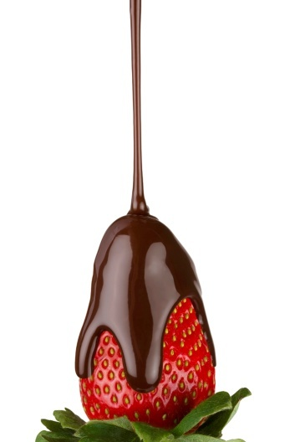

“Name That Change!”
Physical and Chemical Changes
Michelle Todd
Sugar Hill Elementary School

Slide 2
Lesson Goals and Objectives
You will learn what physical changes are and how matter can change from one state to another.
You will learn how chemical changes can cause some kinds of matter to become new matter.

Slide 3
What are physical changes?
Physical changes are changes in the way matter looks.
Changes in size and shape are physical changes.
A physical change can also take place when matter changes from one state to another state.
Can you think of ways that you can physically change a sheet of paper?

Slide 4
Here are some ways you can physically change a sheet of paper:
Cutting
Tearing
Shredding
Folding
Painting
Writing on
Gluing

Slide 5
What are chemical changes?
Chemical changes are the opposite of physical changes.
Chemical changes take place when matter changes to a different kind of matter.

Slide 6


Here are some examples of chemical changes:
campfire
rust

Slide 7
Quick Review
What is a physical change?
A physical change is a change in the size, shape, state, or appearance of matter.
What is a chemical change?
A chemical change causes matter to become a new kind of matter.

Slide 8
You are now ready to play
“Name That Change!”
How To Play
For each item, you will need to tell whether a physical or a chemical change has taken place!

Slide 9

physical

Slide 10
chemical

Slide 11
physical

Slide 12
physical

Slide 13

chemical

Slide 14
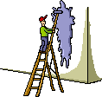
physical

Slide 15
Butter melting
physical

Slide 16
physical

Slide 17
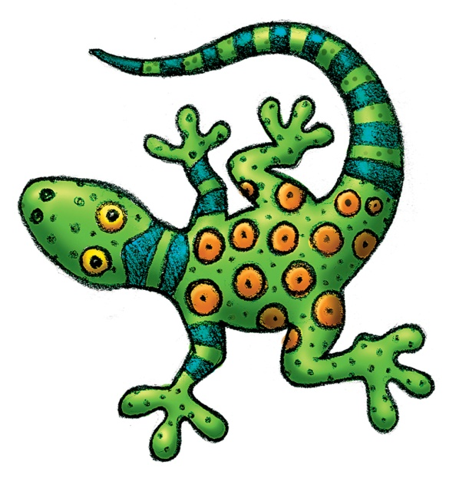
Lizard changing color
chemical

Slide 18
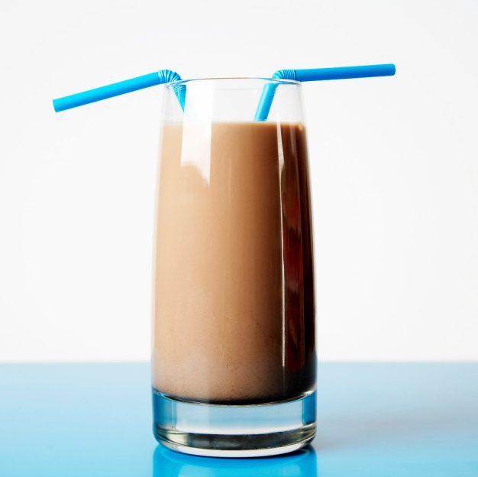
Chocolate Milk
physical

Slide 19
Glass breaking
physical

Slide 20

Spoiling food
chemical

Slide 21

Fireworks exploding
chemical

Slide 22
Hammering nail into board
physical

Slide 23
Cake baking
chemical

Slide 24
Car Rusting
chemical

Slide 25
Water Evaporating
physical

Slide 26
Candle burning
chemical

Slide 27
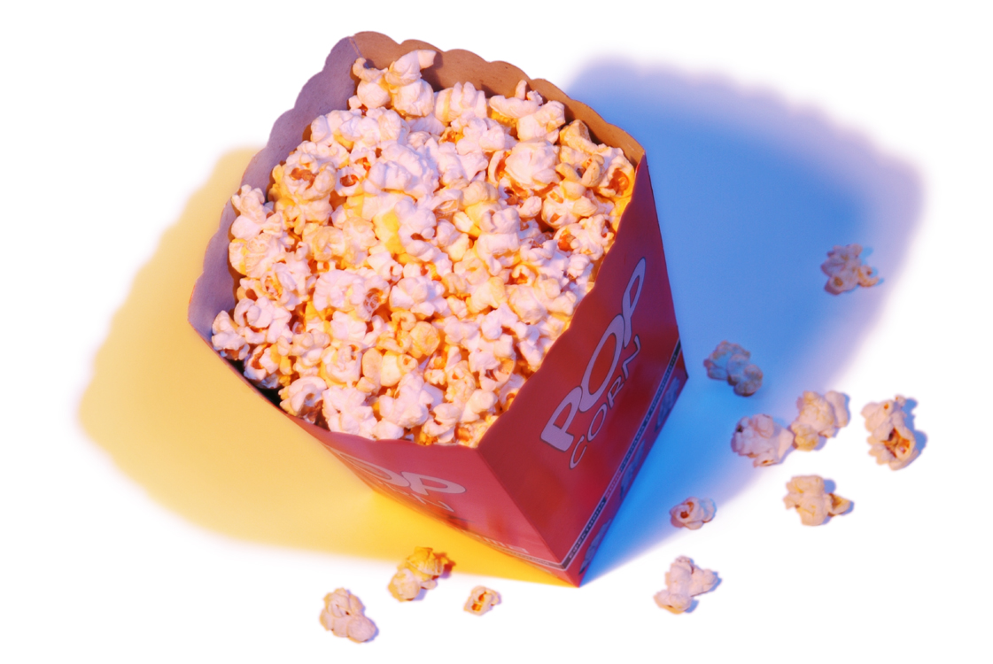
Popcorn popping
physical

Slide 28
Burnt toast
chemical

Slide 29
Vinegar and Baking Soda
chemical

Slide 30

Leaves burning
chemical

Slide 31
Scissors cutting paper
physical

Slide 32
NOW the BONUS ROUND:
TRULY TOUGH TRUE AND FALSE FOR THE TRULY TALENTED

Slide 33
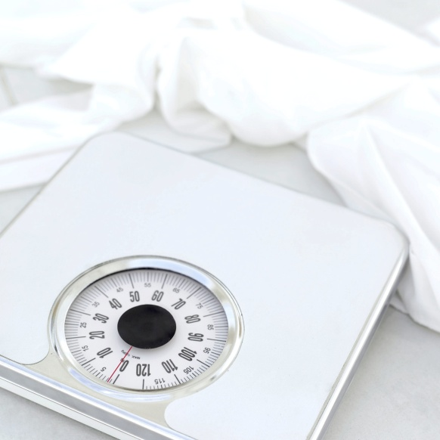
TRUE OR FALSE:
Weight is the amount of matter in an object
false

Slide 34
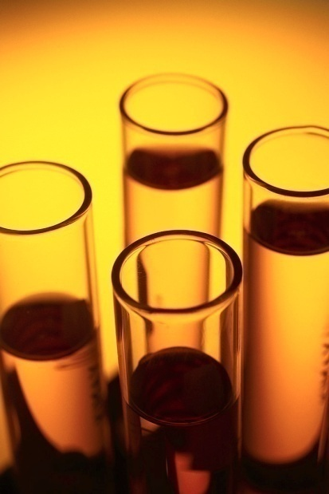
TRUE OR FALSE:
A chemical change is a change in matter which the type of matter stays the same.
false

Slide 35
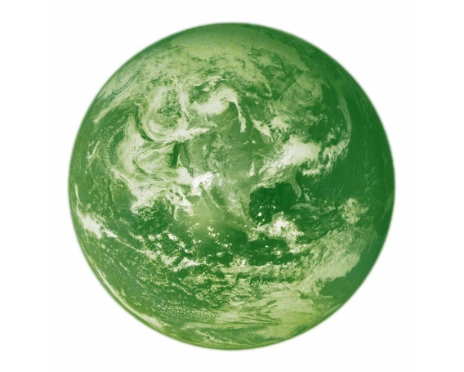
TRUE OR FALSE:
An object on the moon weighs as much as an object on the Earth
false

Slide 36
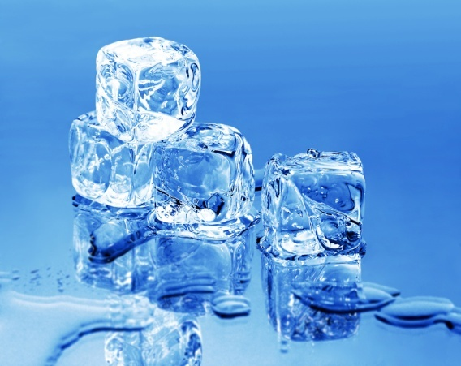
TRUE OR FALSE:
The freezing point is the temperature at which a liquid changes state into solid
true

Slide 37
TRUE OR FALSE:
A physical change is a change in matter that forms a new type of matter.
false

Slide 38


TRUE or FALSE
A penny tarnishing is a physical change.
false

Slide 39
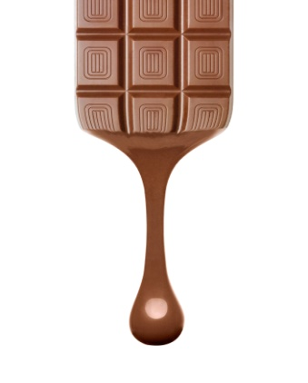

True or False
Wax, chocolate and ice melting are all chemical changes because new substances were created.
false

Slide 40

Congratulations!
You have successfully played “Name That Change!”

