Slide 1
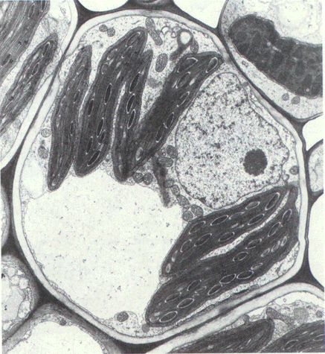
Plant and Animal Cells

Slide 2
All living things are made of...

Slide 3
CELLS!

Slide 4
Plant Cells

Slide 5
Vacuole
The vacuole stores waste, food, and water.
The vacuole is LARGE in a plant cell.
There is only ONE in a plant cell

Slide 6
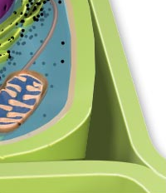
Cell Wall
The cell wall is ONLY found in a plant cell.
The cell wall holds the cell together.

Slide 7
Mitochondria
The mitochondria creates energy for the cell.

Slide 8
Cell Membrane
The cell membrane lets materials pass in and out of the cell.

Slide 9
Chloroplast
The chloroplasts make food for the cell with the help of sun light.
This is where the plant gets its green color.

Slide 10
Nucleus
The nucleus is like the “brain” of the cell.
The nucleus is the control center of a cell.
In a plant cell, the nucleus is small

Slide 11
Cytoplasm
The jelly-like fluid that all of the plant parts sit in

Slide 12
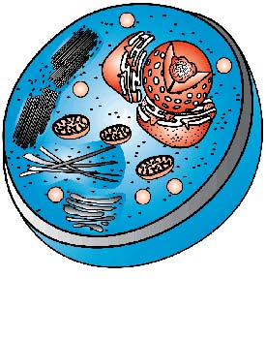
Animal Cells

Slide 13
Vacuole
The vacuole in an animal cell is small
There is more than one vacuole in an animal cell

Slide 14
Mitochondria
The mitochondria creates energy for the cell.

Slide 15
Nucleus
This is the control center of the cell.
The nucleus is large in an animal cell.

Slide 16
Cell Membrane
The cell membrane allows material to pass in and out of the cell.
The cell membrane holds the cell together

Slide 17
Cytoplasm
The jelly-like fluid that holds the cell parts.

