Slide 1
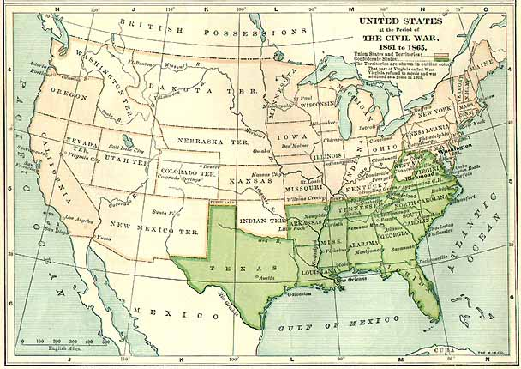
Reconstruction: The New South
Standard 5-1 The student will demonstrate an understanding of Reconstruction and its impact on the United States.
5-1.1 Summarize the aims and course of Reconstruction, including the effects of Abraham Lincoln’s
assassination, Southern resistance to the rights of freedmen, and the agenda of Radical
Republican.
5-1.2 Explain the effects of Reconstruction, including new rights under the thirteenth, fourteenth, and
fifteenth amendments; the actions of the Freedmen’s Bureau; and the move from a plantation
system to sharecropping.
5-1.3 Explain the purpose and motivations of subversive groups during Reconstruction and their rise
to power after the withdrawal of federal troops from the South.
5-1.4 Compare the political, economic and social effects of Reconstruction on different populations in
the South and in other regions of the United States.

Slide 2
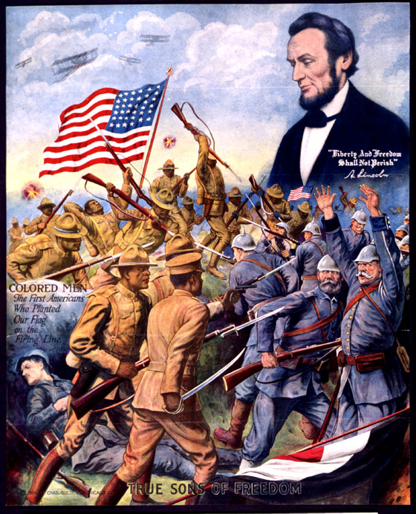
Reconstruction
Reconstruction – a period of rebuilding after the Civil War, during which the Southern states rejoined the Union.

Slide 3
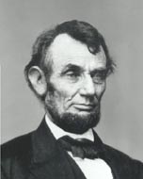
The aims of Reconstruction were different for different groups of Americans.
Goals for Reconstruction
Abraham Lincoln's aim was to preserve the Union and end the Civil War as quickly as
possible.
He promised:
An easy reconstruction for the south in order to persuade southern states to surrender.
He wanted to be fair to the south in defeat because he wanted to heal and unite the country.

Slide 4
Lincoln’s easy Presidential Plan
he promised if 10% of citizens of a southern state (a.k.a. former Confederates) would pledge allegiance to United States AND ratify (accept) 13th amendment (which was to abolish, or get rid of, slavery) …
then
  States could
  form a new state government
  elect representatives to Congress
  fully participate in Union again

Slide 5
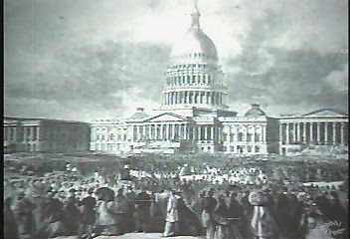
The Assassination of Abraham Lincoln
April 15, 1865

Slide 6
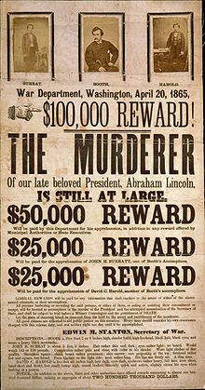
Lincoln was assassinated 6 days after Lee surrendered to Grant at Appomattox Court House, Virginia.
John Wilkes Booth killed Lincoln, and the government hunted for him until they found him.
His assassination did not immediately change the course of Reconstruction.
Lincoln's easy Reconstruction policy would have continued if he had lived.
Lincoln was determined to protect the rights of freed slaves.

Slide 7
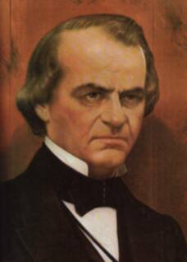
Vice President Andrew Johnson became
President of the United States
Continued Lincoln’s Reconstruction policy but:
Johnson’s aim was to humiliate the southern elite.
Required wealthy land owners to ask for presidential
pardon, he wanted them to acknowledge his power.
Allowed southern states to pass Black Codes.
(Black codes allowed very few rights for
African Americans.)
Allowed southern states to form new state governments.

Slide 8
Southerners aim was to bring the war to an end but:
They didn’t want their society to change.
THEY WERE NOT WILLING TO GRANT
RIGHTS TO FREEDMEN (former slaves)
even though they recognized the end of
slavery.
They replaced slave codes with Black codes
which gave freedmen very little freedom.
they used violence and threats to
intimidate(scare) freedmen.
The Ku Klux Klan was one group that did this.

Slide 9
The United State Congress aim for Reconstruction was to make sure
the Civil War had not been fought in vain.
the freed slaves would remain free.
The United States Congress had its own plan for Reconstruction. This is called the Congressional Reconstruction Plan.

Slide 10
The Congressional Reconstruction Plan (also known as Radical Reconstruction):
DID NOT ALLOW Confederates to be elected as senators and representatives in Congress.
Supported Freedmen’s Bureau protecting rights of freedmen against Black Codes.
Passed 14th Amendment (Citizenship for African Americans)
Military occupation of the south.
The term “Radical Reconstruction” was a term that was used by southern critics to discredit Congressional Reconstruction by labeling it radical or excessive (drastic).

Slide 11
Southern African Americans (recently freed slaves) aim for Reconstruction were different than Southern Whites.
The SAAs wanted:
Education & land rights
To have equal citizenship
Wanted their family and community to be brought together since they had been spread apart among families
Independence
To establish a network of churches, etc.
To vote & be elected into office

Slide 12



Amendments

Slide 13

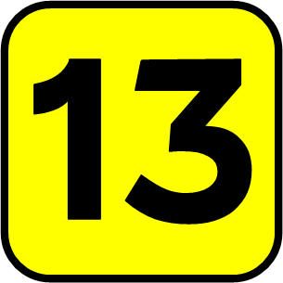
13th Amendment
Freed ALL slaves in the United States (it was not the Emancipation Proclamation)
Lincoln only freed slaves in the states still controlled by the Confederacy
The Confederate government did not recognize his right to do so.
This amendment recognized the rights of all American’s to “life, liberty and the pursuit of happiness” as promised in the Declaration of Independence

Slide 14
14th Amendment
This over turned the Dred Scott decision and recognized the citizenship of African Americans.
All citizens had the right to “due process of law” and equal “protection of the law”
ALL African Americans were affected, not just the south
citizenship

Slide 15
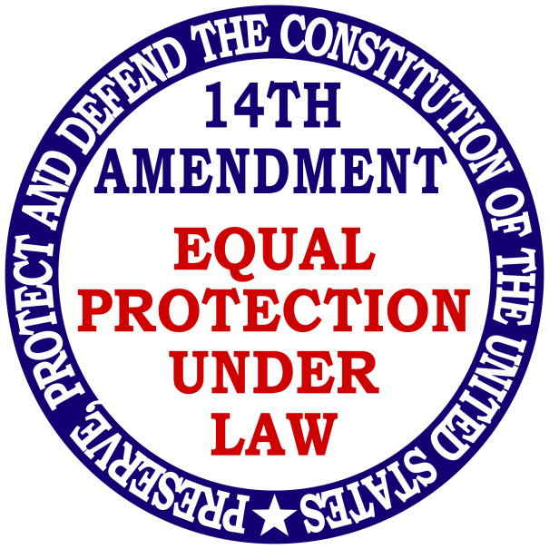
14th Amendment
Southern states refused to ratify the amendment and so the Congressional Reconstruction was imposed
Also included provisions for lessening the political power of states that did not recognize the rights of citizens to vote.
These provisions were not effective and led to the passage of the 15th amendment

Slide 16
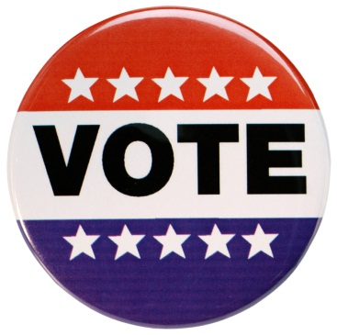
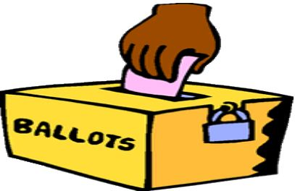
15th Amendment
Gave rights to ALL male citizens to vote
Could not be denied based on “race, creed, or previous condition of servitude”
Affected ALL African Americans
Southern states were required to write new constitutions that allowed African Americans to vote

Slide 17
15th Amendment
Southerners claimed that Congress passed this amendment to protect the power of the Republican Party.
Effects of this amendment were African Americans could:
  Vote
  Hold political office
  Were elected to state legislatures and congressional delegations

Slide 18
13, 14, 15 Amendments
Designed to protect rights of African Americans
But only effective as long as the Republicans had control of state governments or federal troops were able to protect African American’s social and political rights.
African Americans still had no right to own land, therefore southerners refused to sell land

Slide 19
Economic rights and independence of freemen were still limited, even during the Reconstruction period.
Once Reconstruction ended, there was no protection for any rights for African Americans.
----------------------------------------------------------------
Come up with an acronym for 13th, 14th, & 15th amendment
13th – Slavery, 14th – Citizenship, 15th – Voting
S
C
V

Slide 20
Subversive Groups (KKK)
During the Reconstruction period several groups were created to intimidate the freedmen.
The most known subversive group was the Ku Klux Klan:
PURPOSE of KKK: wanted whites to regain control of state governments
A social organization of ex-Confederate soldiers (most were businessmen, lawyers, judges, politicians, etc.)
A terrorist group that used violence, intimidation (lynching), and voter fraud to keep African Americans from exercising their rights under the 13th, 14th, and 15th Amendments.
by 1876… subversive groups had achieved their purpose. The election of 1876 was so damaged with fraud that the electoral votes in three states were questioned. The House of Representatives decided the results of the election.
Democrats agreed to support the election of the Republican candidate in exchange for the removal of all federal troops from the South (Compromise of 1877).
This Compromise of 1877 resulted in the end of Reconstruction and African Americans were abandoned by the federal government. Democrats won control of the southern state governments.

Slide 21

Freed men…
Had no money to purchase land
Little opportunity to work for wages since little currency was available in the South
Entered into agreements with white landowners to trade labor for land in an arrangement known as sharecropping
Sharecropping - in exchange for the right to work the land, poor whites and African Americans would be given a share of the crop they grew.

Slide 22
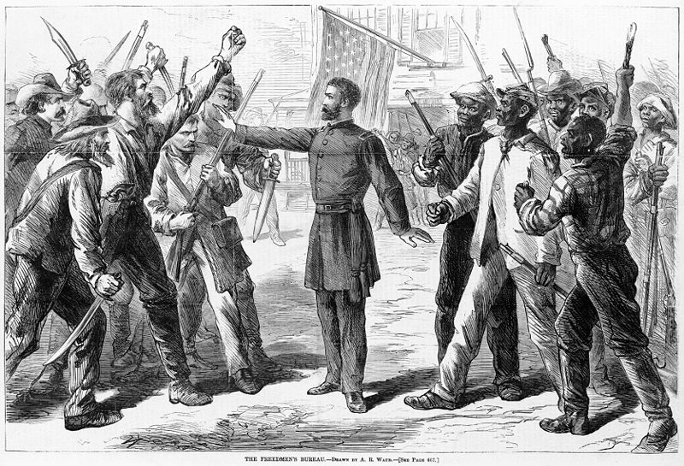
Freedman’s Bureau

Slide 23
Freedman’s Bureau
Established before the end of the Civil War
Bureau was never effectively staffed or funded.
First line of assistance to ALL people in the South in need
What did it do?
Provided food, clothing, medical care, education and protection from the hostile white environment in the South
Helped freemen find jobs and protection of their labor contracts
However, African Americans were not able to achieve economic independence because they were not allowed to have their own land to farm, so the Freedman’s Bureau helped to build relationships with worker-less plantation owners with African Americans to establish sharecropping
The biggest contribution of the Bureau would be the establishment of over 1,000 schools throughout the South

Slide 24

Acquiring Land…
Acquire – to get
Most African Americans tried, but for the most part, it was denied.
General Sherman advocated distribution of “forty acres and a mule” to African American war refugees and some land was distributed during and shortly after the Civil War.
Later, the federal Government returned most lands to white landowners that had been confiscated from the Confederates and given to freedman.

Slide 25
Effects
The end of slavery (not Reconstruction policy) changed society in the South.
Economic effects:
Southern elite – wanted to quickly reestablish cotton production and get back their “high social status” and regain political power.
Sharecropping
State taxes were raised in order to provide for schools and other public services.
Some land owners were unable to pay the taxes, so they lost their land.
Most landowners continued to own their land and be the social “elite” of the South. They had economic control over the sharecroppers and they regained political control as a result of the end of Reconstruction.

Slide 26
… … …
Most Northerners and Southerners were interested in reestablishing a labor system of high productivity at little cost to the investor.
For poor whites, the Reconstruction period allowed some to have a political voice for the first time. Because they cooperated with the Republican government in the South, they were called ‘scalawags’ by the Southern elite and remained in a position of social inferiority.
scalawags

Slide 27
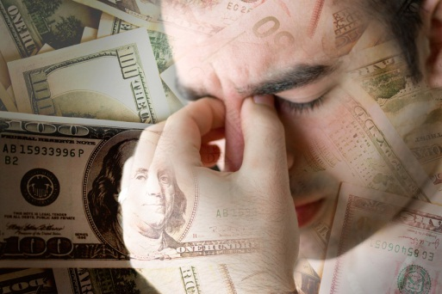
… … …
Some poor whites entered into sharecropping or tenant farming relationships with landowners. Like African-American sharecroppers, they were economically dependent on the land owner for land and credit. These poor farmers needed cash advances on the crop in order to feed their families while they waited for the harvest. Often the harvest did not cover the debt or the farmer needed to borrow again the next year in order to sustain his family. This kept the sharecropper in a condition of constant debt and poverty and restricted his ability to improve his economic situation by either moving or changing crops.
Use a thinking map to write this info. Which thinking map makes the most sense?

Slide 28
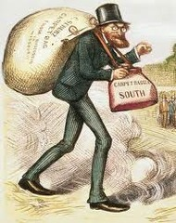
Northerners Moving to the South?
Some Northerners moved to the South during Reconstruction.
Southerners accused these Northerners of taking advantage of the South and called them “carpetbaggers.”
The term “carpetbaggers” suggested that they were opportunists who had packed all of their belongings in a carpetbag and come south to line their own pockets.
However, the historical record shows that most of the Northern migrants came as missionaries and entrepreneurs to help educate the freedmen and rebuild the economy of the South.
carpetbaggers

